Slide 1



ADSEI-B
Data
Visualization
Data Visualization Project
(Trends of climate change)

Slide 2

Topics
ADSEI-B
Data Visualization Project
Client’s Overview
Problem Definition
Our approach
Selection of Data
Selection of Tools
Our Roadmap
Team

Slide 3

Client’s Overview
ADSEI is an Australian Data Science Education Institute.
ADSEI are registered charity using Data Science to engage students with technology and give them the tools they need to create real and positive change in their communities.
ADSEI aims to support teachers to use Data Science to create genuine learning opportunities within their own disciplines.
Source: https://adsei.org/

Slide 4

Problem Definition
Visualization of a selected data set for meaningful insight generation.
We are in an era where data has a number of hidden things abstracted.
Deriving information from these raw datasets help in adding a meaningful conclusion. One of the approaches to perform it is to develop a tool that helps for visualizing data-sets in different meaningful patterns.
The main aim of this project is to deduce visualization pattern of selected data set that would help teachers and their class to explore it in an interactive, engaging way deriving various meaningful insights.

Slide 5
Our Approach
Data Selection
Data Cleansing
Data Visualization
At this stage, we will chose the most appropriate data having wider scope and priority.
We perform filtrations as per the requirement using different platforms for necessary visualizations.
The data shall be visualized using different models as scatterplots, histograms, pie charts, statistical findings, etc. as per users selection.
Data Prediction (Future Scope)
A simple prediction shall be deduced on basis of the data analysed for example, what will be the temperature in 2030, etc.

Slide 6
Data Selection
Dataset:Climate Change: Earth Surface Temperature Data
Source: http://berkeleyearth.org/
We are well aware of the fact that the global world temperature is on a rise every day. The imbalance of mercury with unusual rise and fall leads a potential thread to the global humankind. The core reason of selection of climatic change data-set is to visualize all different data patterns available from the prospect of reflecting the patterns in temperature change which could describe itself the potential threats and measure we shall take for solving the issues encountered. As a wider scope we will be categorizing the data as per decades and predict the temperature of next 20 years on basis of the dataset analysed.

Slide 7
Data Selection Contd.
Climate Change Data for visualizing different patterns.
Attribute Name | Type | Description
Dt | Date | Defines the date of record taken
AverageTemperature | Real | Defines the recorded average temperature of one day.
AverageTemperatureUncertainty | Real | The difference/average errors or deviation.
City | Text | The city where temperature has been measured.
Country | Text | The country where temperature has been measured.
Latitude | Real | Latitude of the place.
Longitude | Real | Longitude of the place.

Slide 8
Selection of Tools
It is to be noted that the tools and frameworks that we have selected are tentative and can be changed in the intial stages of the project if required.
Front End Tech – HTML & CSS and Bootstrapping Framework.
Back End Tech – NodeJS and Python.
Database Tech – IBM Cloud.
Visualization Tool – D3.JS, nvd3, Tableu

Slide 9
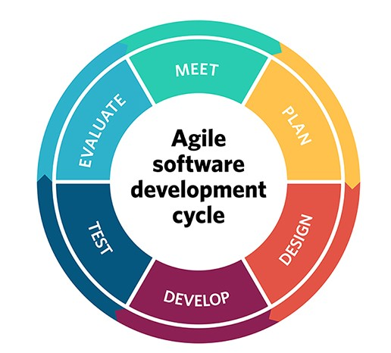
RoadMap
We will divide the project into roughly 5 Sprints focusing on the different stages of the project:
Project Planning
Project Analysis & Design
Project Development
Testing & Deployment Phase
At the end of each sprint we will present to our
Supervisor and client with completed deliverables.

Slide 10
Proposed Visualization Patterns
Basis Statistics
Histogram
Scatter Plot
Bar chart
Pie Chart
Box Plot
Bar stacked
Bubble Representation
Temperature representation of different countries.
Temperature representation by cities of a country.
Statistical representation of temperature and its trend.
Representation of mostly affected countries by temperature hike.
Necessary prediction of temperature which might occur in near future (future scope).

Slide 11


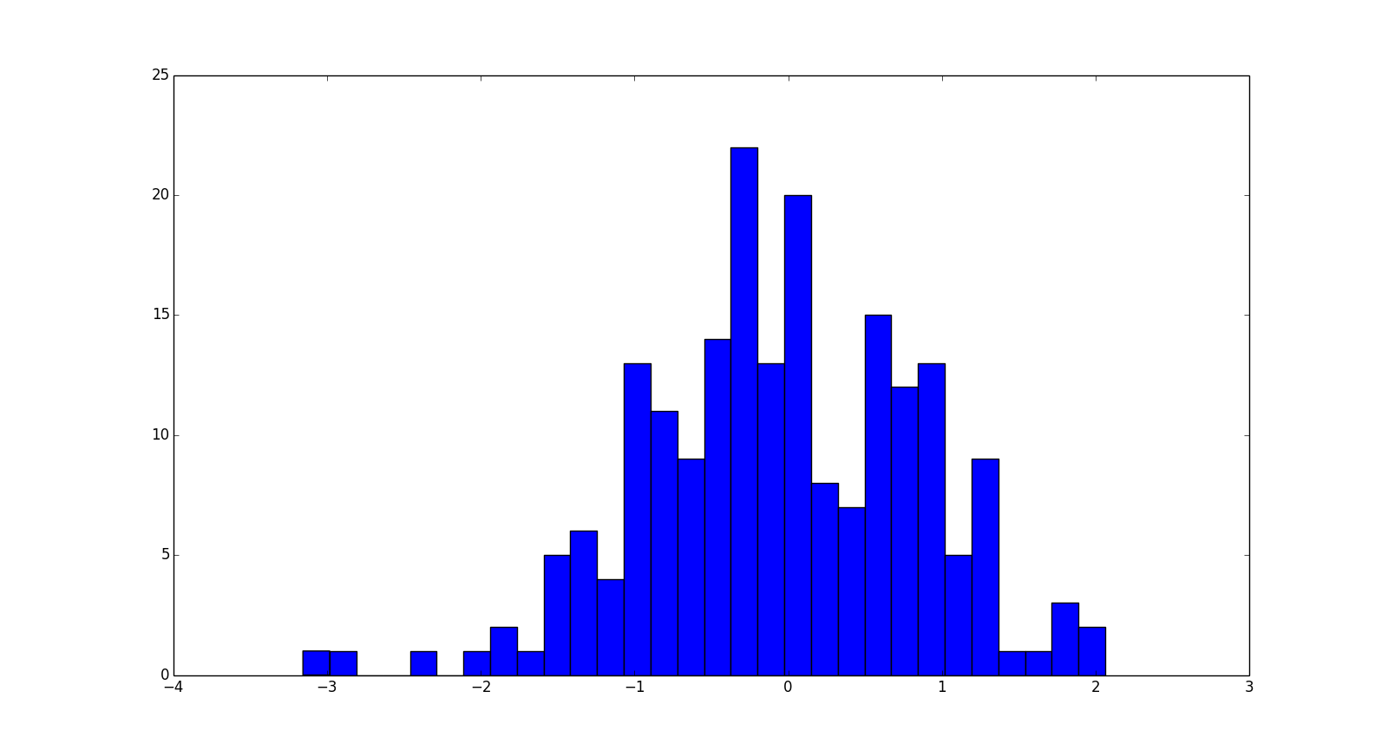
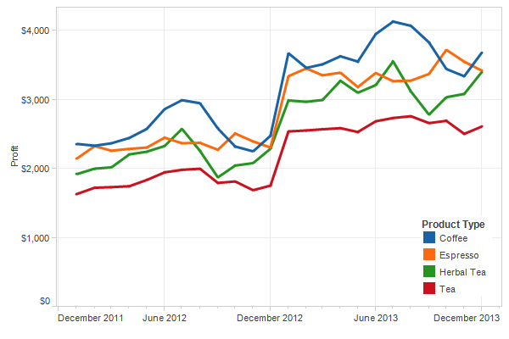
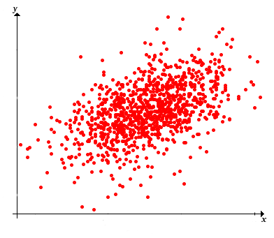
Proposed Visualization Patterns

Slide 12
Future Scope
The project itself holds an excellent prospective future scope when it comes to providing Students & Teachers alike with a learning experience of the teachings of Data science. It can include different types of predicting models which many current industry professionals utilize in order to make critical decisions for business and communities alike. Hence, including such learning opportunities would be very fruitful for the end goal of the product itself which is to promote the teachings of Data Science to prospective Australian Students & Teachers.

Slide 13







Team Members
Anish Raj Pandey
Usman Tariq Syed
Pratik Bhandari
V L Durga Seerapu
Team Lead
Student, Masters of IT,
Deakin University
Product Owner
Student, Masters of IT,
Deakin University
UI/UX Designer
Student, Masters of IT,
Deakin University
Back End Developer
Student, Masters of IT,
Deakin University
Educational Content Creator
Faiq Ul Hassan
Rohail Khan
Pendayala Mohith Chowdary
Back End Developer
Student, Masters of IT,
Deakin University
Front End Developer
Student, Masters of IT,
Deakin University
Front End Developer
Student, Masters of IT,
Deakin University

Slide 14
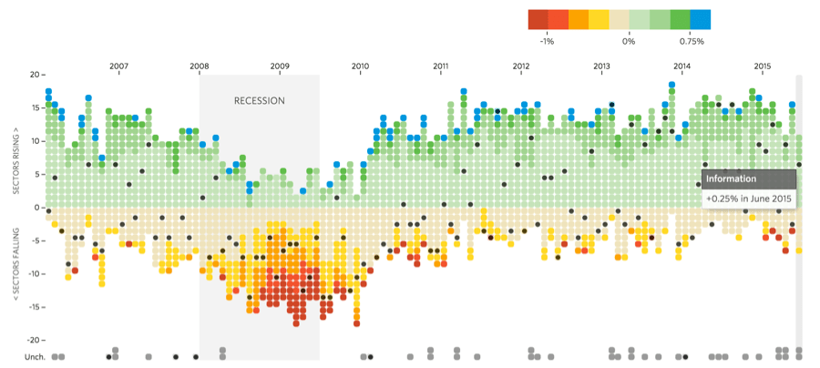
Thank You.
ADSEI-B

